Slide 1
k-Nearest Neighbor (kNN)
Syed Shayan Ali Shah

Slide 2
Outline
k-Nearest Neighbor (kNN) Algrorithm Overview
Algorithm Formulation
Distance Metrics
Choice of k
Algorithm Convergence
Storage, Time Complexity Analysis
Fast kNN
The Curse of Dimensionality

Slide 3
Supervised Learning
Classification Algorithms or Methods
Predicting a categorical output is called classification
Bayesian Methods
Frequency Table
Decision Trees
Covariance Matrix
Linear Dis. Analysis
Logistic Regression
Classification
Similarity Function
K Nearest Neighbor
Neural Network
Others
Support Vector Machine

Slide 4








k-Nearest Neighbor (kNN) Algorithm
1-Nearest Neighbor:
Simplest ML Classifier
Idea: Use the label of the closest known point
Label should be red.
Generalization:
Determine the label of k nearest neighbors and assign the most frequent label
Label should be red
Label should be blue
k=3
k=7

Slide 5
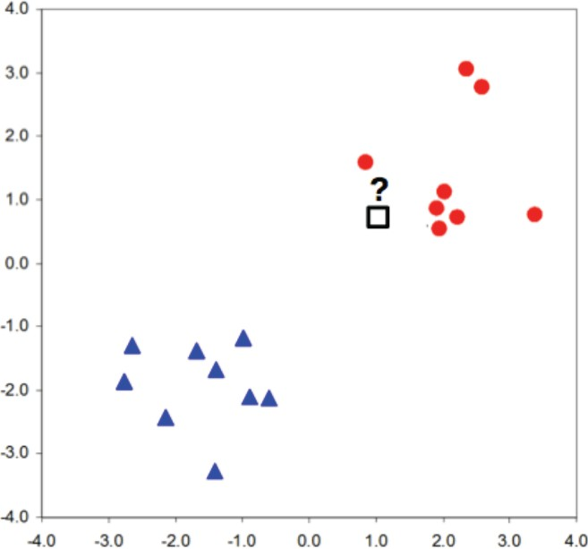
k-Nearest Neighbor (kNN) Algorithm
Idea:
- Two classes, two features
- We want to assign label to unknown data point?
?
- Label should be red.

Slide 6
k-Nearest Neighbor (kNN) Algorithm
Idea:
We have similar labels for similar features.
We classify new test point using similar training data points.
Algorithm overview:
Given some new test point x for which we need to predict the class y.
Find most similar data-points in the training data.
Classify x “like” these most similar data points.
Questions:
How do we determine the similarity?
How many similar training data points to consider?
How to resolve inconsistencies among the training data points?

Slide 7
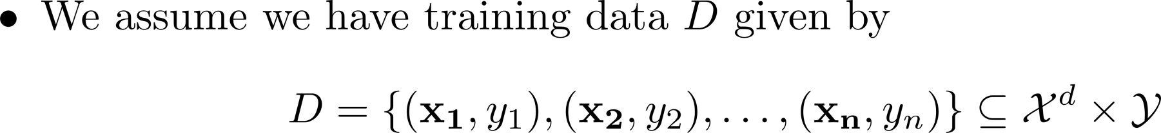
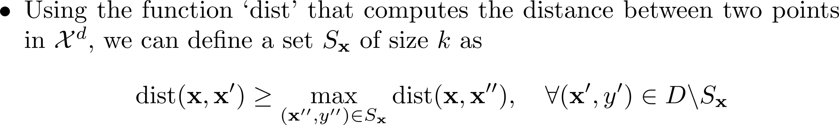
k-Nearest Neighbor (kNN) Algorithm
Formal Definition:
Interpretation:

Slide 8
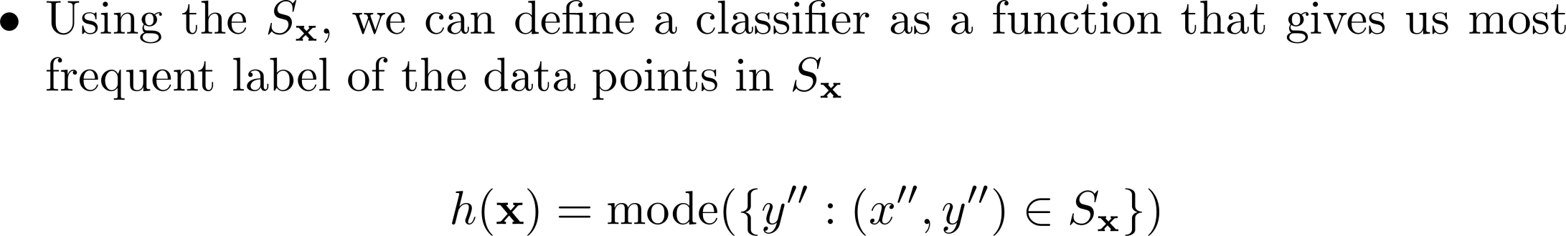
k-Nearest Neighbor (kNN) Algorithm
Formal Definition:

Slide 9
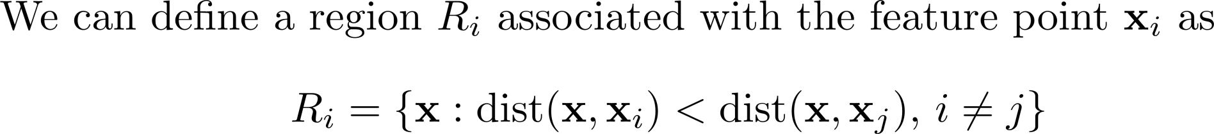
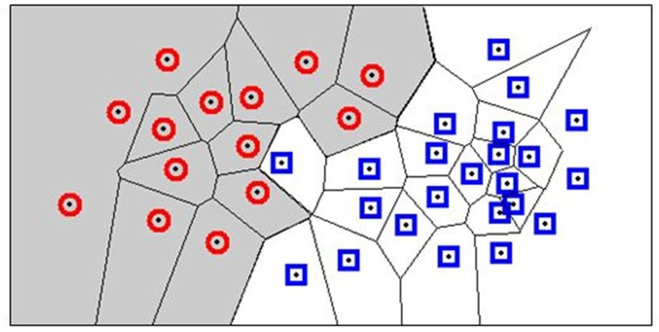
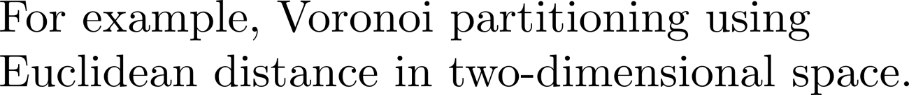
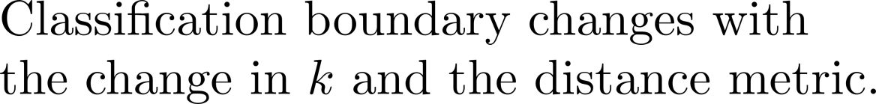
k-Nearest Neighbor (kNN) Algorithm
Decision Boundary:

Slide 10
k-Nearest Neighbor (kNN) Algorithm
Characteristics of kNN:
No assumptions about the distribution of the data
Non-parametric algorithm
  No parameters
Hyper-Parameters
  k (number of neighbors)
  Distance metric (to quantify similarity)
- Complexity (both time and storage) of prediction increases with the size of training data.

Slide 11
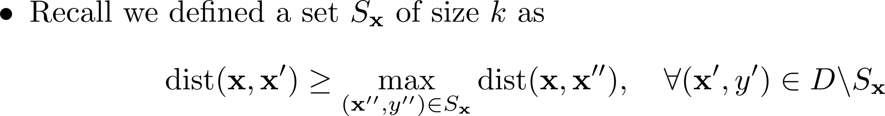
k-Nearest Neighbor (kNN) Algorithm
We need to define distance metric to find the set of k nearest neighbors, S_{x}

Slide 12
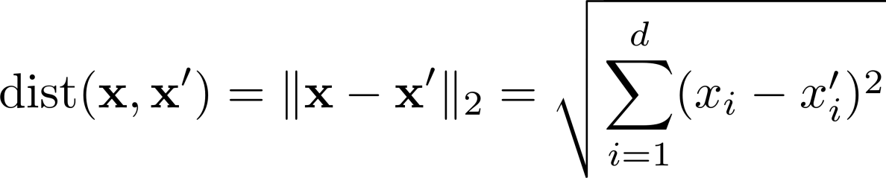

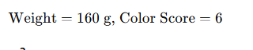
k-Nearest Neighbor (kNN) Algorithm
Distance Metric:
Fruit | Weight (g) | Color Score | Type
1 | 150 | 7 | Apple
2 | 170 | 6 | Apple
3 | 140 | 8 | Apple
4 | 130 | 7 | Apple
5 | 180 | 5 | Apple
6 | 200 | 9 | Orange
7 | 220 | 8 | Orange
8 | 210 | 10 | Orange
9 | 190 | 9 | Orange
10 | 205 | 7 | Orange

Slide 13
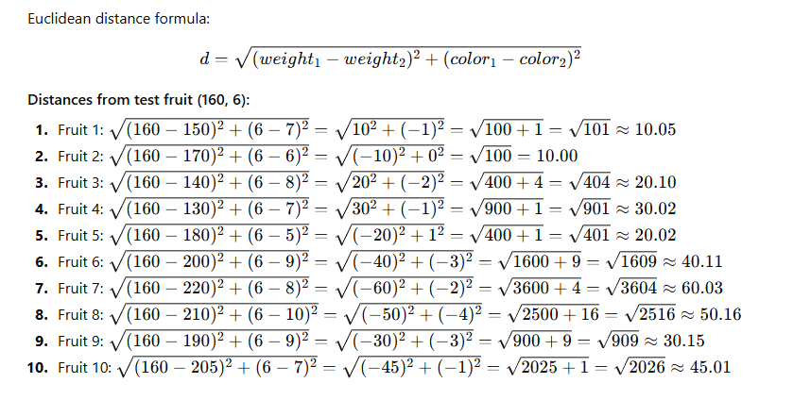
k-Nearest Neighbor (kNN) Algorithm
Distance Metric:

Slide 14
k-Nearest Neighbor (kNN) Algorithm
Distance Metric:
Fruit | Distance | Type
2 | 10.00 | Apple
1 | 10.05 | Apple
3 | 20.10 | Apple
5 | 20.02 | Apple
4 | 30.02 | Apple
9 | 30.15 | Orange
6 | 40.11 | Orange
10 | 45.01 | Orange
8 | 50.16 | Orange
7 | 60.03 | Orange

